Slide 1
Raspa
A sharing platform…

Slide 2
The Idea.
We believe that a huge leap towards making cities smarter can be made by optimizing the usage of public and private resources by ordinary citizens.
With this objective, we have developed our website – RASPA, an internet based product that aims to incentivize public citizens to pool in their resources and reduce the clutter caused by overload of public and private resources (transport, utilities, working and living spaces, maintenance, etc.)
Notes:
With this objective, we have developed our website RASPA, an internet based product that aims to incentivize public citizens to pool in their resources and reduce the clutter caused by overload of public and private resources (transport, utilities, working and living spaces, maintenance, etc.)

Slide 3
And The Perks!
concept of 'smart points‘
citizens will be credited RSPs based on the resources they offer for pooling.
Redemption of RSPs against
govCash (a voucher that can be used against payments made for government services)
tax credits (redeem smart points and get tax refunds)
cash (get a percentage of cash transferred to bank account) etc.

Slide 4



Our Service.

Slide 5
A Demonstration.
PRODUCT | RSPs
Mobile/Tablet | 16 – 580
PCs | 80 – 2050
Displays | 40 – 240
Other Electronics | 40 – 160
Kitchen Appliances | 1 – 160
Clothes | 1 – 100
Furniture | 40 – 240
Books and Stationary | 1 – 40
Automobile | 160 – 20000

Slide 6
A glimpse of the website!

Slide 7


Slide 8
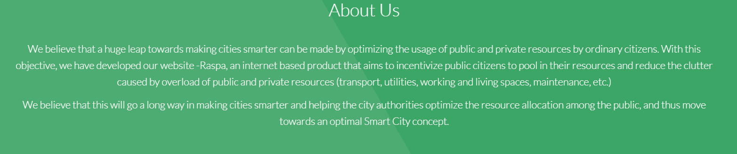
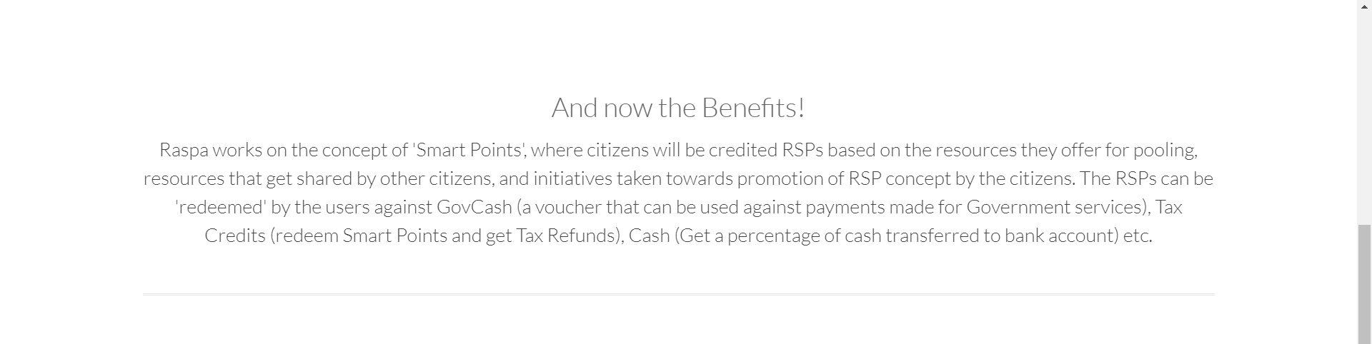

Slide 9
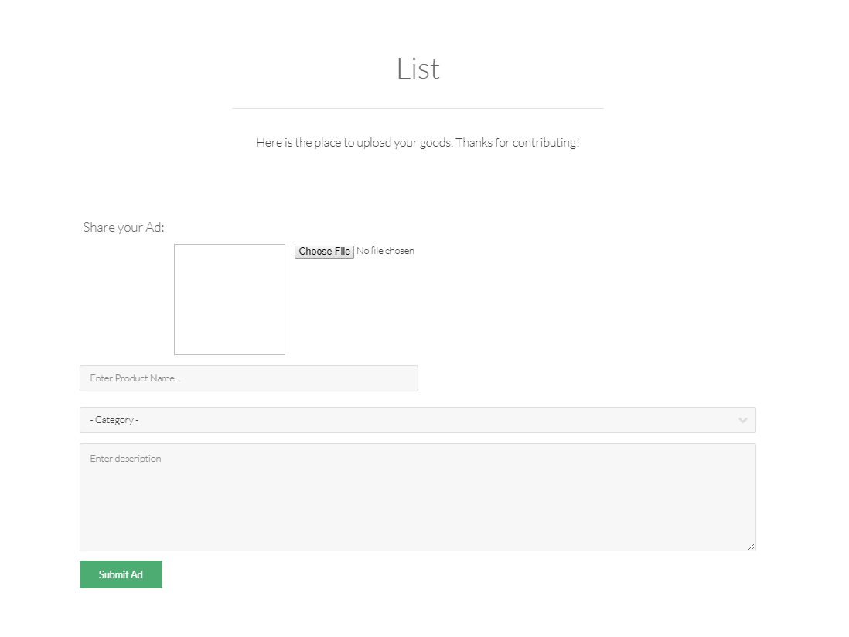

Slide 10
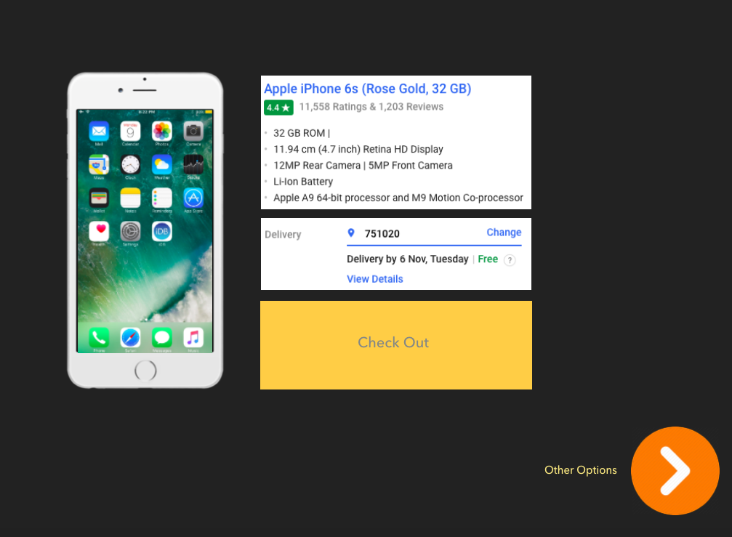

Slide 11
Thank You…

